Slide 1

by Christian Schneeweiß & Harald Burgstaller

Slide 2

What is Firebase?
Founded by James Tamplin and Andrew Lee (2011)
2014 acquired by Google
Mobile and Web application development plattorm
Deploy tools and infrastructure

Slide 3
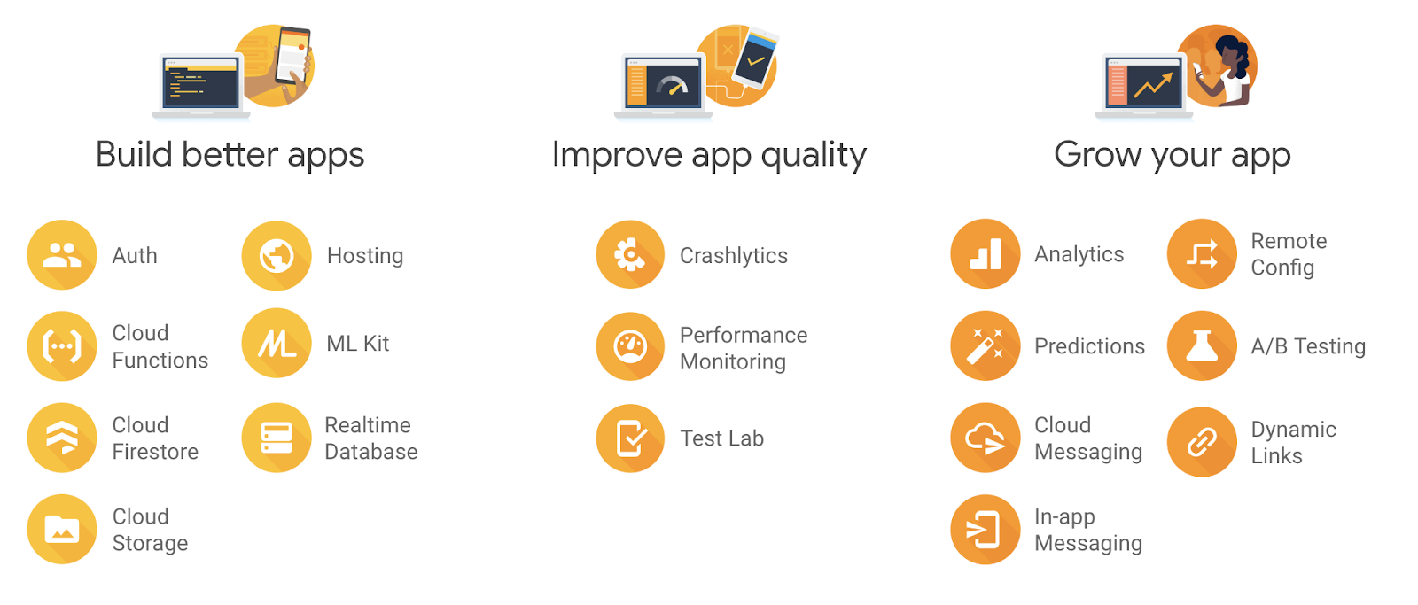
Big Picture

Slide 4
Realtime Database
Cloud-hosted NoSQL database
Document store via JSON
Real Time interaction of users and online presence
Cross-platform apps share one Realtime Database instance and automatically receive updates with the newest data

Slide 5
Authentication
Provides backend services, easy-to-use SDKs, and ready-made UI libraries to authenticate
about 10 lines of code necessary
You can sign in users either by using FirebaseUI as a complete drop-in authentication solution or by using the Firebase Authentication SDK
Email & Password, Facebook, Google, Phone number, …

Slide 6
Crashlytics
Is a lightweight, realtime crash reporter that helps you track, prioritize, and fix stability
It saves you troubleshooting time by intelligently grouping crashes and highlighting the circumstances that lead up to them
Figure out which lines of code are causing crashes

Slide 7
Cloud Storage
Standalone solution for uploading user-generated content like images and videos from iOS, Android and Web
Specifically designed to scale your apps, provide security, and ensure network resiliency
Uses simple folder/file system to structure its data

Slide 8
Advantages
Free to use
Open Source (GitHub)
Full integration to existing Google products
Google Ads, AdMob, Doubleclick, BigQuery, ...
Cross-plattform compatible
Android, iOS, Web Apps, …
Excellent documentation
Free Support

Slide 9
Price
A/B Testing | Free | Free | Free
Analytics | Free | Free | Free
Authentication | 10k/month | 10k/month | $0.06/verification
Cloud Firestore | 1 GiB total | 2.5 GiB total | $0.18/GiB
Cloud Messaging (FCM) | Free | Free | Free
Crashlytics | Free | Free | Free
Performance Monitoring | Free | Free | Free
Realtime Database | 1 GB | 2.5 GB | $5/GB
Storeage | 5 GB | 50 GB | $0.026/GB

Slide 10
Live Demo
https://bit.ly/2N9NVdE
iOS App
Setup database
Add new project
Connect database with XCode project
Save and delete items in realtime
Authentication or login with email and password
See online users

